Slide 1


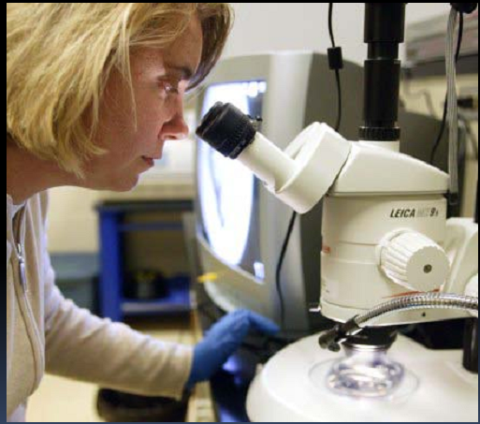
GLTS 201 HAZARDS AND SAFETY IN THE LABORATORY Lecturer: Opadele A.E

Slide 2
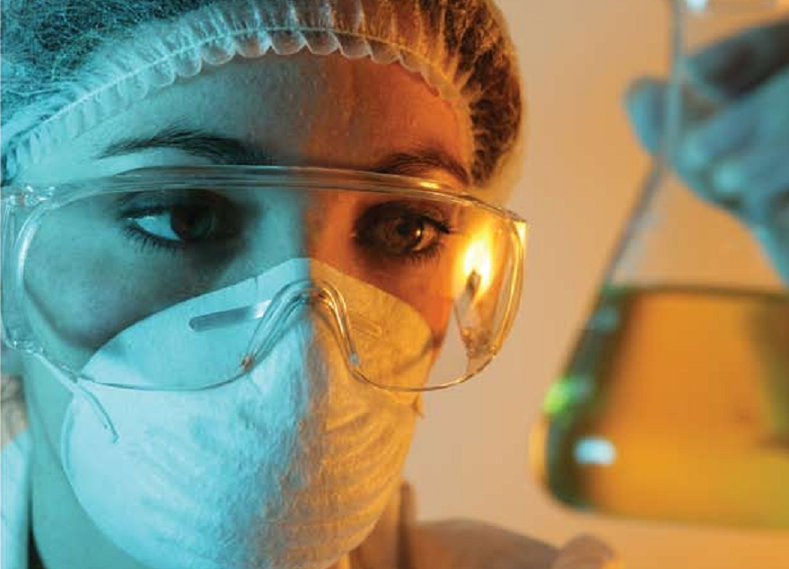
ACCIDENTS AND CONTROL MEASURES (PART ONE)
COURSE OBJECTIVES:
Common laboratory accidents/injuries and their control measures
Hazards and caution in the use of electricity supplies
Causes of fire in the laboratory
Precautions against fire and explosion
Action in an emergency involving fire explosion and implosion
Burns and Scalds
Types of Operation of fire-fighting equipment

Slide 3
GENERAL LABORATORY HEALTH AND SAFETY REQUIREMENTS
1.1. No eating or drinking in the laboratory. Consume food and drink only in properly designated areas.
1.2. Applying cosmetics and handling contact lenses is not allowed in laboratories.
1.3. Use the appropriate personal protective equipment (PPE) at all times. Refer to the PPE procedure for more information.
1.4. Use laboratory equipment for its designated purpose.
1.5. Confine long hair and loose clothing.
1.6. Use a proper pipetting device – absolutely no pipetting by mouth.

Slide 4
1.7. Avoid exposure to gases, vapours, aerosols and particulates by using a properly functioning laboratory fume hood. chemical.
1.8. Proper waste disposal procedures must be followed.
1.9 Wash hands upon completion of laboratory work and removal of protective equipment including gloves and laboratory coats. A vigorous hand washing with mild soap for 20 seconds is appropriate.
1.10. Fix unsafe conditions (employees) or report to the Instructor conducting the laboratory (students).
1.11. Know the location and correct use of all available safety equipment.

Slide 5
1.12. Determine potential hazards and appropriate safety precautions before beginning new operations and confirm that existing safety equipment is sufficient for this new procedure.
1.13. Avoid disturbing or distracting other workers while they are performing laboratory tasks.
1.14. Ensure visitors to the laboratory are equipped with appropriate safety equipment.
1.15. All hazardous chemicals must be correctly and labeled in accordance to Workplace Hazardous Materials Information Systems (WHMIS) requirements.
1.16. The Material Safety Data Sheet (MSDS) will be consulted before using an unfamiliar

Slide 6
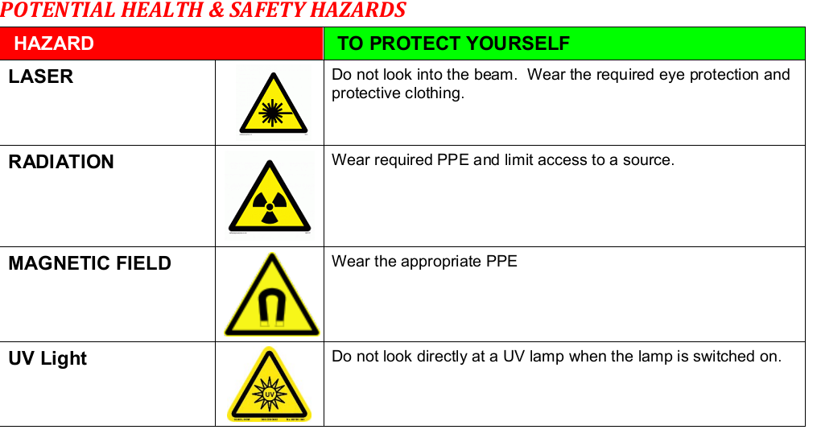

Slide 7
ACCIDENT
Definition: An unexpected event with negative consequences occurring without the intention of the one suffering the consequences.
All laboratory accidents, incidents and near misses are to be attended to immediately.
Individuals who need medical care must be attended to as quickly as possible.
In addition, all accidents, incidents and near misses need to be documented. The documentation is used to determine when corrective action is required.

Slide 8
At the time of an accident, there is often much confusion. It may be difficult to determine if an accident is minor or major. In general, a minor accident can easily be treated with basic first aid.
A major accident is one where basic first aid alone may not be enough. If you are unsure, err on the side of major accident and call 911. In addition, it is important to report all laboratory accidents, regardless of severity.
What appears to be minor (a slip on the floor) can in a few days become major (back pain). It is important therefore to report and document all accidents and injuries with your supervisor, (or appropriate authority).
The appropriate response and reporting in the event of a laboratory accident are as follows. A flowchart of this information is attached:

Slide 9
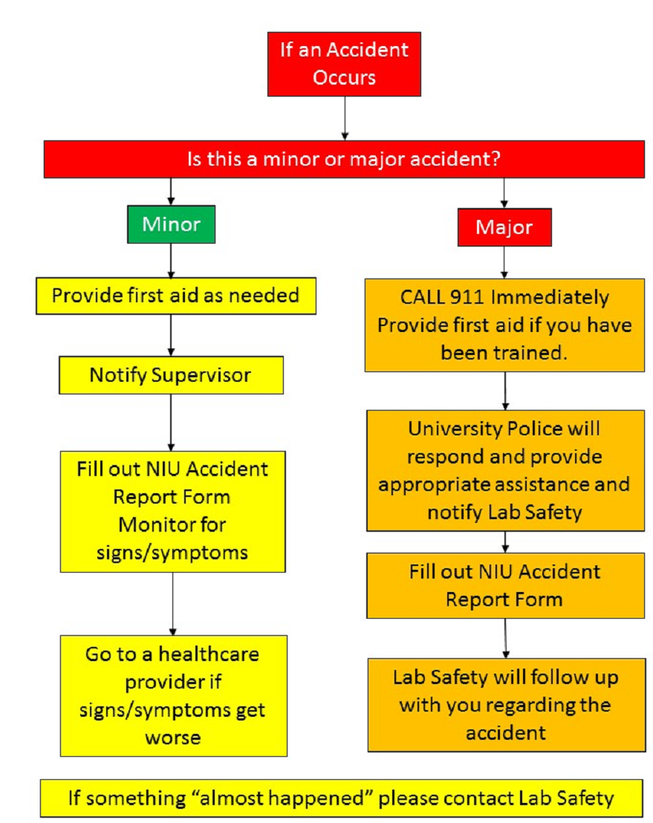
ACCIDENT FLOW CHART

Slide 10
Major Accident
CALL 911 (inform the appropriate authorithies). University Police and Paramedics are trained to provide first aid;
many are trained in advanced medical care. They will use their expertise to
determine if you need medical attention.
i. You are strongly advised to follow the medical advice of first responders.
ii. You have the option of refusing medical treatment or transport.
iii. If your injuries warrant further medical attention, you have the option of
seeking medical treatment through the local emergency department,
immediate care clinic, or your own physician.

Slide 11
Minor Accident
A minor accident is something that requires only first aid. A first aid kit should be
readily available to treat minor accidents. In the event of a minor accident, e.g. a
bite or scratch from an animal, wash thoroughly with soap and water.
Even if the event is minor:
i. Notify your supervisor.
ii. Fill out the Babcock Accident/ Incident Report Form (attached)
iii. Self-monitor for any unusual signs or symptoms. For example, for a cut or
bite these would be fever or signs of infection (redness, swelling or heat at
wound site). If any unusual signs or symptoms occur, seek medical
attention.

Slide 12
Near Miss Reporting
There are times when an incident does not result in an accident.
These are considered near misses.
Although a near miss does not require immediate action, it is important to report these instances. Near misses are indications of potential problems which need to be investigated further.
Use the Accident/Incident Report Form

Slide 13
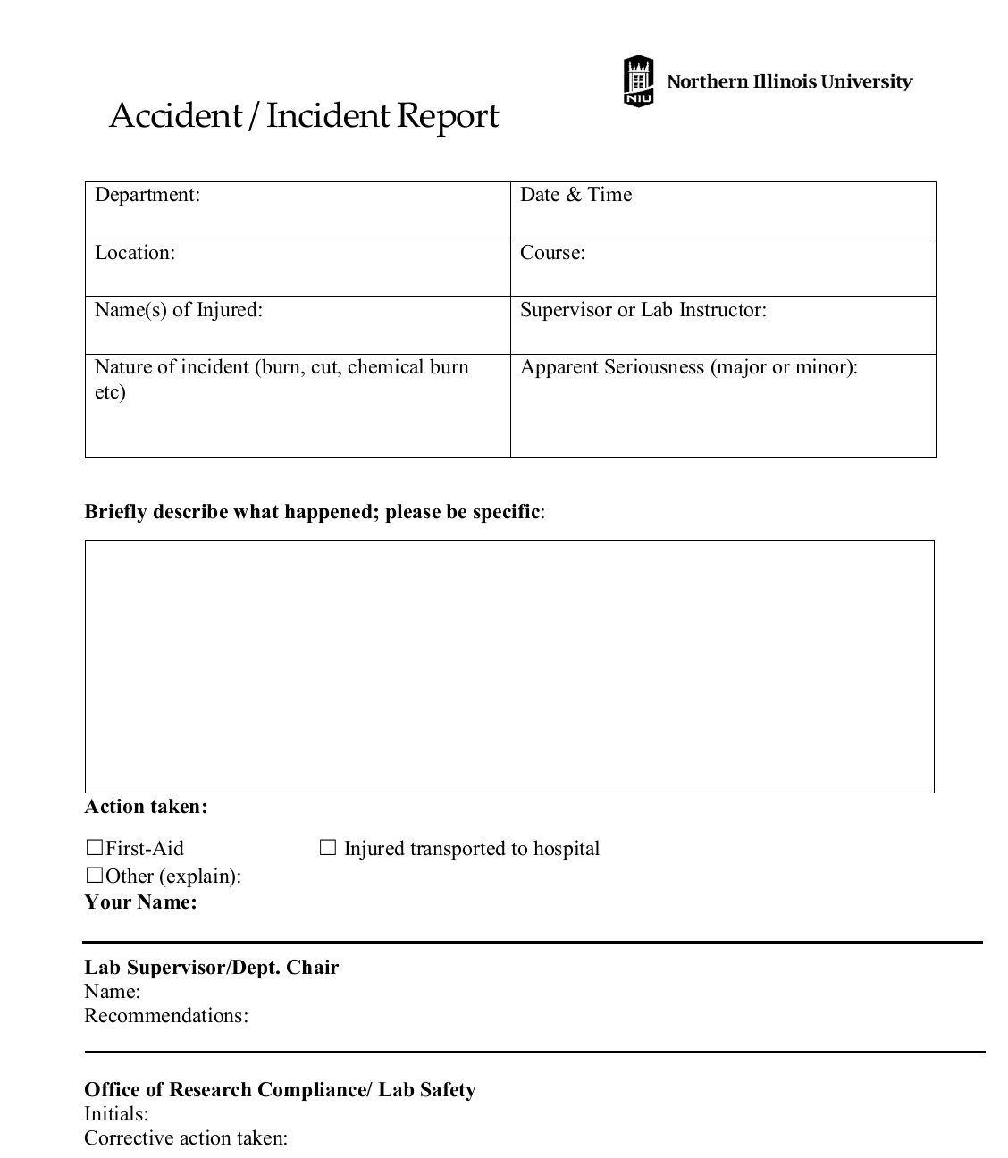

Slide 14
Laboratory Hazards
Numerous physical hazards may be present in the laboratory. While not as exotic as chemical and biological hazards, physical hazards are responsible for the majority of workplace injuries.
It is important to be aware of these hazards, preplan, use personal protective equipment and follow basic safety rules in order to prevent accidents involving physical hazards.
This document describes physical hazards that may be found in BU laboratories.
Some sections/information may also be applicable to the field work and non-laboratory tasks.
The basic template for this appendix was obtained from Cornell University and is used with their permission.

Slide 15
Equipment Related Hazards
A) AUTOCLAVES
Autoclaves present a number of physical hazards such as:
• Heat, steam, and pressure.
• Thermal burns from steam and hot liquids.
• Cuts from broken or exploding glass.
B) BATTERIES
Batteries present a number of potential hazards. Charged batteries are “always on.” Care must be taken to ensure that electrodes of batteries in storage do not contact each other leading to fire.
Lead acid batteries contain corrosive liquids and also generate hydrogen gas during charging which poses an explosion hazard.
OSHA requires adequate ventilation to prevent hydrogen build up and an eyewash/safety shower in battery charging locations.

Slide 16
B) BATTERIES
Lithium batteries may burst into flames if overcharged, and nickel cadmium and lead acid types contain heavy metals. Almost all rechargeable batteries are capable of sufficient output current to start fires if short-circuited.
Because of these sorts of hazards, and disposal considerations, a more detailed document has been developed.
SHOCK HAZARDS (ELECTRICAL SAFETY)
Electricity travels in closed circuits, and its normal route is through a conductor.
Shock occurs when the body becomes a part of the electric circuit. Electric shock can cause direct injuries such as electrical burns, arc burns, and thermal contact burns.

Slide 17
It can also cause injuries of an indirect or secondary nature from involuntary muscle contractions from the electric shock.
These injuries can include bruises, bone fractures, and even death resulting from collisions or falls.
Death may also occur from damage to internal organs and cardiac arrest.
Electrical shock generally occurs from contact in one of three ways:
Both wires of the electric circuit, or
• One wire of the energized circuit and the ground, or
• A metallic part that has become energized by being in contact with an
energized wire, and another part or ground.

Slide 18
The severity of the shock received when a person becomes a part of an electric circuit is affected by three primary factors:
The amount of current flowing through the body (measured in amperes).
The path of the current through the body.
The length of time the body is in the circuit.

Slide 19
Common Laboratory Electrical Hazards and Preventative Steps
New equipment may have different hazards than those you are familiar with.
Before operating new equipment read and follow all equipment operating instructions for proper use.
Access panels and covers may shield high voltages.
Do not take apart laboratory instruments or attempt electrical repairs unless you are a qualified technician assigned to perform electrical work by your supervisor.
Fixed wiring may only be repaired or modified by Facilities personnel or an approved outside repair service vendo

Slide 20
Wet hands, salt solutions, and some anti-static devices may enhance electrical contact with the body.
Use extra caution and ground fault circuit interrupter (GFCI) devices when these conditions exist.
Remove rings, watches and other jewelry, which may become part of an electrical circuit when working around electricity.
The accidental or unexpected starting of electrical equipment can cause severe injury or death

Slide 21
Common laboratory equipment that may automatically start includes:
Vacuum Pumps (may start from remote pressure transducer or instrument controller)
Air compressors (may start on demand from pressure set point)
Auto samplers (may move under computer or instrument control)
Ovens (thermostat controlled)
Cryostats (thermostat controlled)
Chillers (thermostat controlled)
Air Conditioners (thermostat controlled)
Lasers (many have a safety delay in producing a beam, or warm up time for tubes or cavities)
Sump or feed pumps (actuated by fluid level)

Slide 22
Unplugging something does not necessarily make it safe.
Capacitors may store a lethal charge and battery circuits, such as those found in Uninterruptible Power Supplies, also remain live.
Be extra cautious with these types of devices and apply the applicable energy controls techniques to mitigate the hazard.
Instruments in breadboard (developmental) form must be energized only under the direct supervision of the technician, and not left unattended while live unless protective measures are taken to exclude accidental contact with any exposed hazards.
Finished devices fabricated for experimental purposes must be sufficiently enclosed to preclude contact with any exposed hazards and be properly grounded.

Slide 23
Improper use of extension cords is hazardous.
If you need additional power supply, the best solution is to have additional outlets installed by Facilities.
Do not use extension cords or power strips ("power taps") as a substitute for permanent wiring.
Never daisy chain extension cords or power strips to get power where it is needed.
Corrosives found in the laboratory environment may deteriorate wiring or insulation.
Common causes of cracked insulation are the:
mineral acids and bases, ozone, heat, and ultraviolet light.
Inspect all electrical and extension cords for wear and tear.
Pay particular attention near the plug and where the cord connects to the piece of equipment.
If you discover a frayed electrical cord or corroded contacts, lock the equipment out and make arrangements for repair before reuse.

Slide 24
Many electrical devices are also potential ignition sources.
Never store flammable liquids such as solvents or fuels near electrical equipment, even temporarily.
Avoid cluttered work areas and benches because they invite accidents and injuries.
Good housekeeping and a well-planned layout of temporary wiring will reduce the dangers of fire, shock, and tripping hazards.
Electrical equipment must not be installed near eye wash/safety shower stations

Slide 25
MECHANICAL HAZARDS
Many laboratory instruments have moving parts. Some of these devices are automatic samplers, belt-driven pumps, centrifuges, fans, shakers, mixers, and rotary evaporators.
Generally these machines have safeguards or interlocks to prevent machinery-related injuries, however, caution must always be exercised around moving parts. If working with such equipment, follow these safety guidelines:

Slide 26
Avoid wearing loose fitting clothing or necklaces that could be drawn into a rotating assembly.
Do not defeat interlocks on doors, access panels, etc.
Do not brake moving parts by hand; wait for motion to stop on its own.
Be aware of assemblies that vibrate and could “walk” into other objects or fall off a counter.
Safety glasses must always be worn around any power tool operation.
Use caution with automatic or computer-controlled machines that could start unexpectedly.

Slide 27
VACCUM HAZARDS
Many laboratories employ vacuum apparatus for analytical equipment like mass spectrometers, reactive chemical handling and transfer in Schlenk lines, filtration, and desiccation.
Some general guidelines for glass apparatus under vacuum include:
Inspect glassware that will be used for reduced pressure to make sure there are no defects such as chips or cracks that may compromise its integrity.
Use only approved glassware for low pressure work. Never use a flat bottom flask (unless it is a heavy-walled filter flask) or other thin-walled flask that isnot appropriate to handle atmospheric pressure

Slide 28
Use a shield between the user and any glass under vacuum or wrap the glass with tape to contain any glass in the event of an implosion.
Glass Dewar flasks, some distillation columns, CRTs, and other apparatus are permanently under vacuum.
The same precautions apply to these items. Note that “Thermos” flasks are especially thin and prone to breakage. Wrap them with tape to contain glass shards in the event of an implosion.

Slide 29
PERSONAL PROTECTIVE ELEMENT (PPE)
PPE, is available to provide additional protection to scientists. PPE selection must be based on hazards, experimental conditions of each unique experiment.
Some commonly used types of PPE include:
• Eye Protection - glasses, goggles, face shield
• Gloves - Thin barrier, thick protective, laminate, chemical resistant
• Clothing - Lab coat, whites, scrubs, plastic aprons, other
o Open-toe shoes or sandals are never appropriate in the lab
o Cotton clothing, long pants combined with a lab coat are most effective
when working with caustic, flammable or toxic materials
o Lab coat should always be worn to protect exposed skin, street clothes
• Respirators – many types available, some may require medical evaluation & fit testing before first use

Slide 30
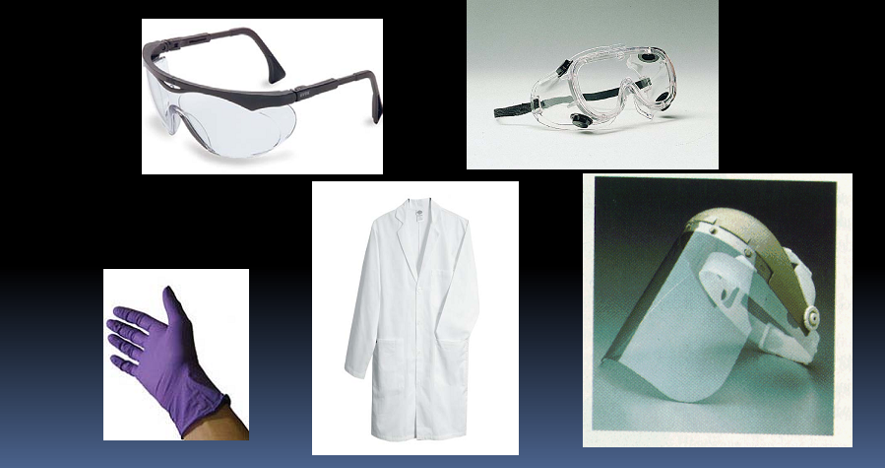

Slide 31
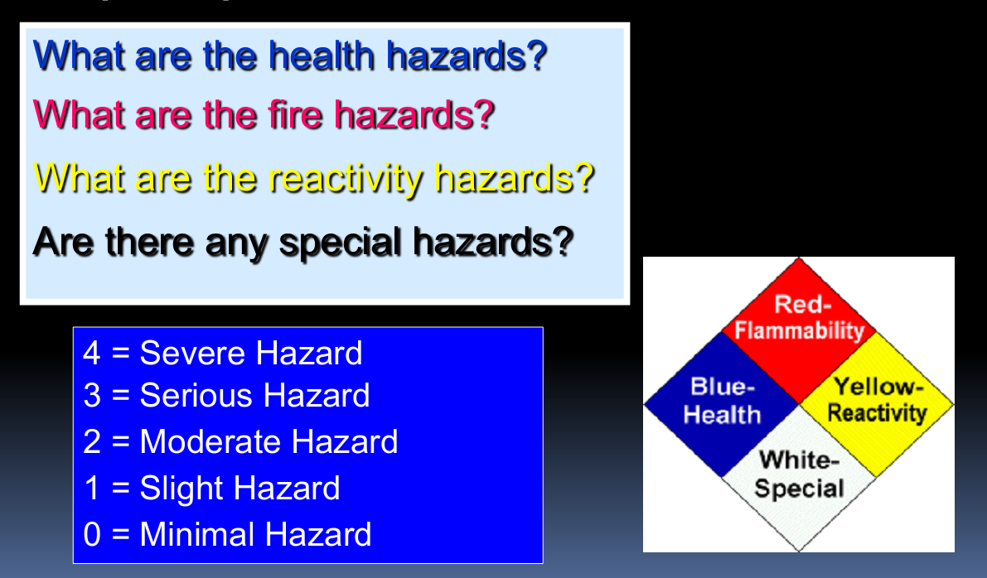
National Fire Protection Association (NFPA) Hazard Labels

Slide 32
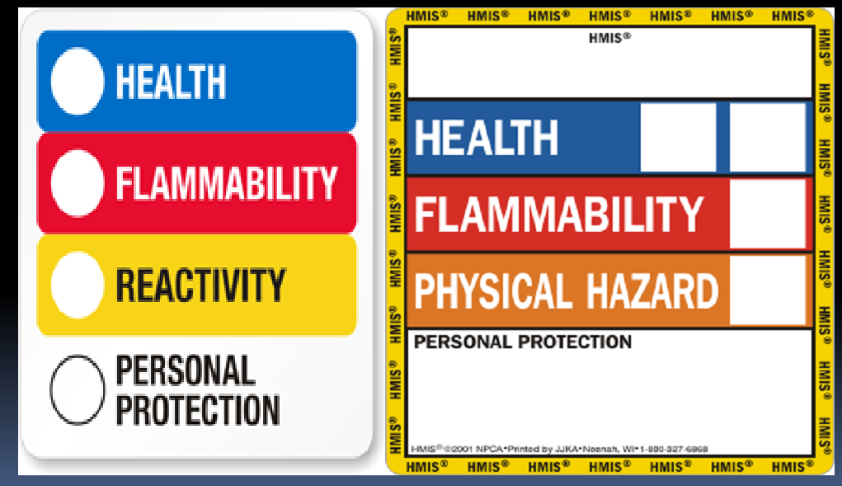
Hazardous Material Identification System (HMIS) Labels

Slide 33
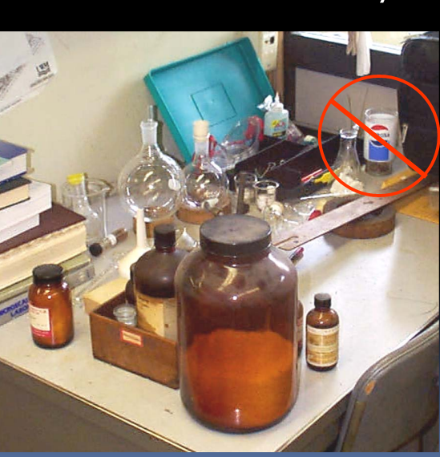

Slide 34
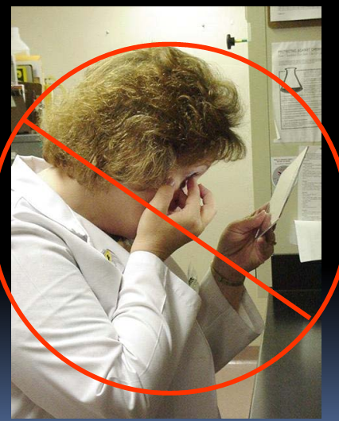

Slide 35
ONLINE RESOURCE
HHMI Online Safety Courses http://www.practicingsafescience.org/
Laboratory Safety Institute http://www.labsafety.org/freedocs.htm
NIOSH Traumatic Occupational Injuries http://www.cdc.gov/niosh/injury/trauma.html
NIOSH Health Hazard Evaluations http://www.cdc.gov/niosh/hhe
www.osha.gov

Slide 36
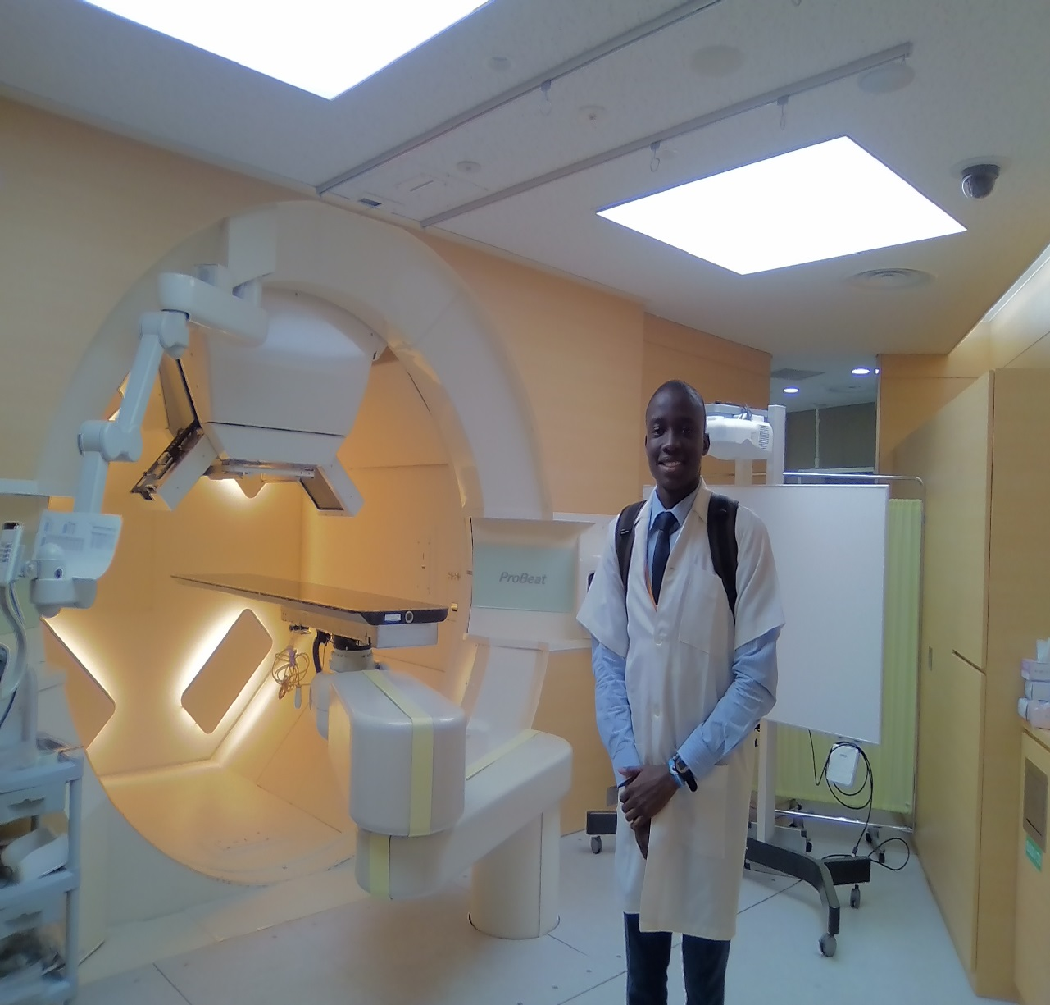
QUESTIONS AND COMMENTS!!!
AT THE PROTON THERAPY CENTER/RESEARCH LABORATORY, HOKKIADO UNIVERSITY, JAPAN
Courtesy: GI-CORE and STANFORD UNIVERSITY

